Slide 1
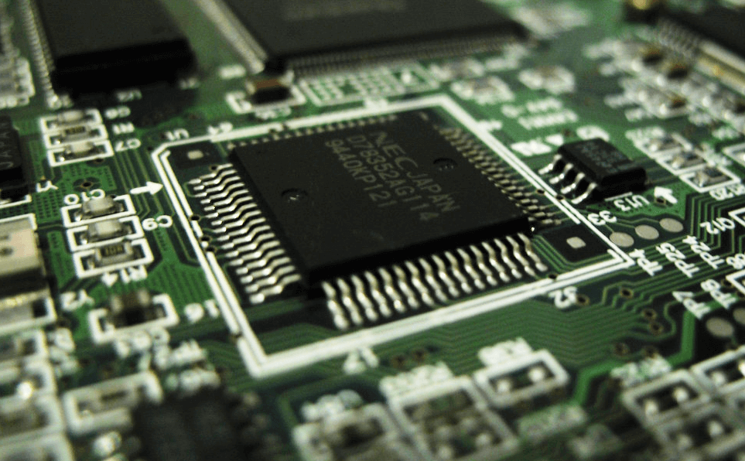
8085 Microprocessor
Dr. Manju Khurana
Assistant Professor, CSED
TIET, Patiala
manju.khurana@thapar.edu

Slide 2
LAB ASSIGNMENT (8085)
Introduction to Microprocessor Based Systems Design
Introduction of 8085-microprocessor kit and steps for execution on the kit.
Familiarity with 8085-microprocessor kit.
i) Write a program to store 8-bit data into one register and then copy that to all registers.
ii) Write a program for addition of two 8-bit numbers.
iii) Write a program to add 8-bit numbers using direct and indirect addressing mode.
iv) Write a program to add 16-bit numbers using direct and indirect addressing mode.
v) Write a program to 8-bit numbers using carry. (using JNC instruction).
vi) Write a program to find 1’s complement and 2’s complement of 8-bit number.
Write a program for the sum of series of numbers.
Write a program for data transfer from memory block B1 to memory block B2.
Write a program for multiply two 8-bit numbers.
Write a program to add ten 8-bit numbers. Assume the numbers are stored in 8500-8509. Store the result in 850A and 850B memory address.
Write a program to find the negative numbers in a block of data.
Write a program to count the number of one's in a number.
Write a program to arrange numbers in Ascending order.
Calculate the sum of series of even numbers.
Write an assembly language program to verify how many bytes are present in a given set, which resembles 10101101 in 8085.
Write an assembly language program to find the numbers of even parity in ten consecutive memory locations in 8085.
Write an assembly language program to convert a BCD number into its equivalent binary in 8085.
Write an assembly language program for exchange the contents of memory location.
Write a program to find the largest number in an array of 10 elements.
‹#›

Slide 3
Steps to perform on the Intel kit as well as on Simulator
Introduction to Microprocessor Based Systems Design
Press Reset
Press Examine Memory
Enter starting address
Press Next
Enter opcodes by subsequently pressing Next
Press Reset
Press Go
Enter starting address of the program to compile
Press EXEC/FILL
Press Reset
Press Examine Memory
Enter Output Address
Press Next
‹#›

Slide 4
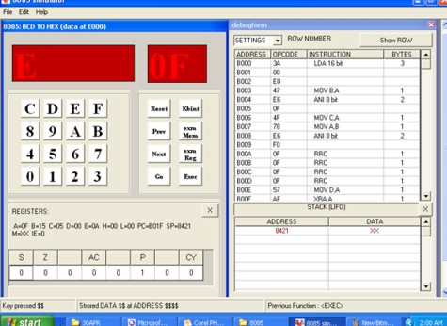
Vikas Simulator Screenshot
Introduction to Microprocessor Based Systems Design
‹#›

Slide 5
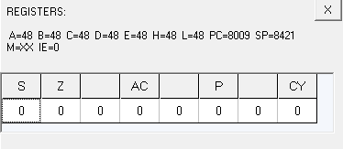
Program No. 2.1: Write a program to store 8-bit data into one register and then copy that to all registers.
Introduction to Microprocessor Based Systems Design
Code | Memory Location | Opcode
MVI A, 48 | 8000, 8001 | 3E, 48
MOV B, A | 8002 | 47
MOV C, A | 8003 | 4F
MOV D, A | 8004 | 57
MOV E, A | 8005 | 5F
MOV H, A | 8006 | 67
MOV L, A | 8007 | 6F
RST 5 | 8008 | EF
Output –
A – 48, B – 48, C – 48, D – 48, E – 48, H – 48, L – 48
‹#›

Slide 6
Program No. 2.2: Write a program for addition of two 8-bit numbers.
Introduction to Microprocessor Based Systems Design
Code | Memory Location | Opcode
MVI A, 48 | 8000, 8001 | 3E, 48
MVI B, 48 | 8002, 8003 | 06, 48
ADD B | 8004 | 80
STA 8500 | 8005, 8006, 8007 | 32, 00, 85
RST 5 | 8008 | EF
Output –
[ 8500 ] – 90
‹#›

Slide 7
Program No. 2.3: Write a program to add 8-bit numbers using direct and indirect addressing mode.
Introduction to Microprocessor Based Systems Design
Code | Memory Location | Opcode
LDA 8500 | 8000, 8001, 8002 | 3A, 00, 85
MOV B, A | 8003 | 47
LDA 8501 | 8004, 8005, 8006 | 3A, 01, 85
ADD B | 8007 | 80
STA 8502 | 8008, 8009, 800A | 32, 02, 85
RST 5 | 800B | EF
Code | Memory Location | Opcode
LXI H, 8500 | 8000, 8001, 8002 | 21, 00, 85
MOV A, M | 8003 | 7E
INX H | 8004 | 23
ADD M | 8005 | 86
INX H | 8006 | 23
MOV M, A | 8007 | 77
RST 5 | 8008 | EF
Input - [ 8500 ] – 88, [ 8501 ] – 88
Output - [ 8502 ] – 10
Input - [ 8500 ] – 88, [ 8501 ] – 88
Output – A – 10
‹#›

Slide 8
8085 Microprocessor
Dr. Manju Khurana
Assistant Professor, CSED
TIET, Patiala
manju.khurana@thapar.edu

Slide 9
Program No. 2.4: Write a program to add 16-bit numbers using direct and indirect addressing mode.
Introduction to Microprocessor Based Systems Design
Code | Memory Location | Opcode
LXI B, 8500 | 8000, 8001, 8002 | 01, 00, 85
LDAX B | 8003 | 0A
MOV D, A | 8004 | 57
INX B | 8005 | 03
LDAX B | 8006 | 0A
ADD D | 8007 | 82
STA 8504 | 8008, 8009, 800A | 32, 04, 85
INX B | 800B | 03
LDAX B | 800C | 0A
MOV D, A | 800D | 57
INX B | 800E | 03
LDAX B | 800F | 0A
ADC D | 8010 | 8A
STA 8505 | 8011, 8012, 8013 | 32, 05, 85
RST 5 | 8014 | EF
Code | Memory Location | Opcode
LHLD 8500 | 8000, 8001, 8002 | 2A, 00, 85
XCHG | 8003 | EB
LHLD 8502 | 8004, 8005, 8006 | 2A, 02, 85
DAD D | 8007 | 19
SHLD 8504 | 8008, 8009, 800A | 22, 04, 85
RST 5 | 800B | EF
Input - [ 8500 ] – 48, [ 8501 ] – 48, [ 8502 ] – 48, [ 8503 ] – 48
Output - [ 8504 ] – 90, [ 8505 ] – 90
Input - [ 8500 ] – 34, [ 8501 ] – 48,
[ 8502 ] – 54, [ 8503 ] – 78
Output – [ 8504 ] – 7C [ 8505 ] – CC
‹#›

Slide 10
Program No. 2.5: Write a program to add 8-bit numbers using carry. (using JNC instruction).
Introduction to Microprocessor Based Systems Design
Code
MVI C, 00
LXI H, 8500
MOV A, M
INX H
ADD M
JNC Next
INR C
Next: INX H
MOV M, A
INX H
MOV M, C
RST 5
Input - [ 8500 ] – 88, [ 8501 ] – 88
Output - [ 8502 ] – 10, [ 8503 ] – 01
‹#›

Slide 11
Program No. 2.6: Write a program to find 1’s complement and 2’s complement of a 8-bit number.
Introduction to Microprocessor Based Systems Design
Code
LDA 8500H
CMA
STA 8501H
RST 5
Code
LDA 8500H
CMA
INR A
STA 8501H
RST 5
Input - [ 8500 ] – 48
Output - [ 8501 ] – B7
Input - [ 8500 ] – 48
Output - [ 8501 ] – B8
‹#›

Slide 12
Introduction to Microprocessor Based Systems Design
Program No. 3: Write a program for the sum of series of numbers.
Code
LDA 8500H
MOV C, A
SUB A
LXI H, 8501H
Back: ADD M
INX H
DCR C
JNZ Back
STA 8600H
RST 5
Input - [8500] – 04, [8501] – 9A, [8502] – 52, [8503] – 89, [8504] – 3E
Result – 1B3 Output - [8600] – B3
‹#›

Slide 13
Introduction to Microprocessor Based Systems Design
Program No. 4: Write a program for data transfer from memory block B1 to memory block B2.
Code
MVI C, 0AH
LXI H, 8500H
LXI D, 8600H
Back: MOV A, M
STAX D
INX H
INX D
DCR C
JNZ Back
RST 5
Input - [8500] – 01, [8501] – 02, [8502] – 03,……… [8509] – 0A
Output - [8600] – 01, [8601] – 02, [8602] – 03,……… [8609] – 0A
‹#›

Slide 14
Introduction to Microprocessor Based Systems Design
Program No. 5: Write a program for multiply two 8-bit numbers.
Code
LDA 8500H
MOV E, A
MVI D, 00
LDA 8501H
MOV C, A
LXI H, 0000H
Back: DAD D
DCR C
JNZ Back
SHLD 8600H
RST 5
Input - [8500] – B2, [8501] – 03
Result – B2 + B2 + B2 = 0216 H Output - [8600] – 16, [8601] – 02
‹#›

Slide 15
Introduction to Microprocessor Based Systems Design
Program No. 14: Write an ALP for exchange the contents of memory location.
Code
LDA 8500H
MOV B, A
LDA 8600H
STA 8500H
MOV A, B
STA 8600H
RST 5
Input - [8500] – 48, [8600] – 88
Output - [8500] – 88, [8600] – 48
‹#›

Slide 16
Introduction to Microprocessor Based Systems Design
Program No. 15: Write a program to find the largest number in an array of 10 elements.
Code
MVI B, 09
LXI H, 8500H
MOV A, M
INX H
Back: CMP M
JNC Next
MOV A, M
Next: INX H
DCR B
JNZ Back
STA 850AH
RST 5
Input - [8500] – 01, [8501] – 02, ………………………. [8509] – 0A
Output - [850A] – 0A
‹#›

Slide 17
Introduction to Microprocessor Based Systems Design
Program No. 6: Write a program to add ten 8-bit numbers. Assume the numbers are stored in 8500-8509. Store the result in 850A and 850B memory address.
Code
MVI C, 00
MVI B, 09
LXI H, 8500H
MOV A, M
Back: INX H
ADD M
JNC Next
INR C
Next: DCR B
JNZ Back
INX H
MOV M, A
INX H
MOV M, C
RST 5
Input - [8500] – FF, [8501] – 01, [8502] – 01, [8503] – 01, [8504] – 01, [8505] – 01, [8506] – 01, [8507] – 01, [8508] – 01, [8509] – 01
Output - [850A] – 08, [850B] – 01
‹#›

Slide 18
Introduction to Microprocessor Based Systems Design
Program No. 7: Write a program to find the negative numbers in a block of data.
Code
LDA 8500H
MOV C, A
MVI B, 00
LXI H, 8501H
Back: MOV A, M
ANI 80H
JZ Skip
INR B
Skip: INX H
DCR C
JNZ Back
MOV A, B
STA 8600H
RST 5
Input - [8500] – 04, [8501] – 56, [8502] – A9, [8503] – 73, [8504] – 82
Result = 02 Output - [8600] – 02
‹#›

Slide 19
Introduction to Microprocessor Based Systems Design
Program No. 8: Write a program to count the number of one's in a number.
Code
LDA 8500H
MVI B, 08
MVI D, 00
Loop1: RLC
JNC Loop2
INR D
Loop2: DCR B
JNZ Loop1
MOV A, D
STA 8600H
RST 5
Input - [8500] – 25 0010 0101
Output - [8600] – 03
‹#›

Slide 20
Introduction to Microprocessor Based Systems Design
Program No. 9: Write a program to arrange numbers in Ascending order.
Code
LXI H, 8500H
MOV C, M
DCR C
Repeat: MOV D, C
LXI H, 8501H
Loop: MOV A, M
INX H
CMP M
JC Skip
MOV B, M
MOV M , A
DCX H
MOV M, B
INX H
Skip: DCR D
JNZ Loop
DCR C
JNZ Repeat
RST5
Input - [8500] – 05, [8501] – 05, [8502] – 04, [8503] – 03, [8504] – 02, [8505] – 01
Input - [8500] – 05, [8501] – 01, [8502] – 02, [8503] – 03, [8504] – 04, [8505] – 05
‹#›

Slide 21
Introduction to Microprocessor Based Systems Design
Program No. 10: Write a program to calculate the sum of series of even numbers.
Code
LDA 8500H
MOV C, A
MVI B, 00
LXI H, 8501H
Back: MOV A, M
ANI 01
JNZ Skip
MOV A, B
ADD M
MOV B, A
Skip: INX H
DCR C
JNZ Back
STA 8600H
RST 5
Input - [8500] – 04, [8501] – 20,
[8502] – 15 , [8503] – 13, [8504] – 22
Output - [8600] – 42
‹#›

Slide 22
Introduction to Microprocessor Based Systems Design
Program No. 11: Write an assembly language program to verify how many bytes are present in a given set, which resembles 10101101 in 8085.
Code
MVI B, 0A
MVI D, AD
MVI C, 00
LXI H, 8500H
Back: MOV A, M
CMP D
JNZ Next
INR C
Next: INX H
DCR B
JNZ Back
MOV A, C
STA 8600H
RST 5
Input - [8500] – AD, [8501] – 01, [8502] – 01, [8503] – 01, [8504] – 01, [8505] – 01, [8506] – 01, [8507] – 01, [8508] – 01, [8509] – 01
Output - [8600] – 01
‹#›

Slide 23
Introduction to Microprocessor Based Systems Design
Program No. 12: Write an assembly language program to find the numbers of even parity in ten consecutive memory locations in 8085.
Code
MVI B, 0A
MVI C, 00
LXI H, 8500H
Back: MOV A, M
ANI FF
JPO Next
INR C
Next: INX H
DCR B
JNZ Back
MOV A, C
STA 8600H
RST 5
Input - [8500] – 01, [8501] – 03, [8502] – 01, [8503] – 03, [8504] – 01, [8505] – 03, [8506] – 01, [8507] – 03, [8508] – 01, [8509] – 03
Output - [8600] – 05
‹#›

Slide 24
Introduction to Microprocessor Based Systems Design
Program No. 13: Write an assembly language program to convert a BCD number into its equivalent binary in 8085.
Code
LDA 8500H
MOV B, A
ANI 0F
MOV C, A
MOV A, B
ANI F0
RRC
RRC
RRC
RRC
MOV B, A
XRA A
MVI D, 0A
Sum: ADD D
DCR B
JNZ Sum
ADD C
STA 8600H
RST 5
Input - [8500] – 67
Input - [8600] – 43
‹#›

Slide 25


